Slide 1
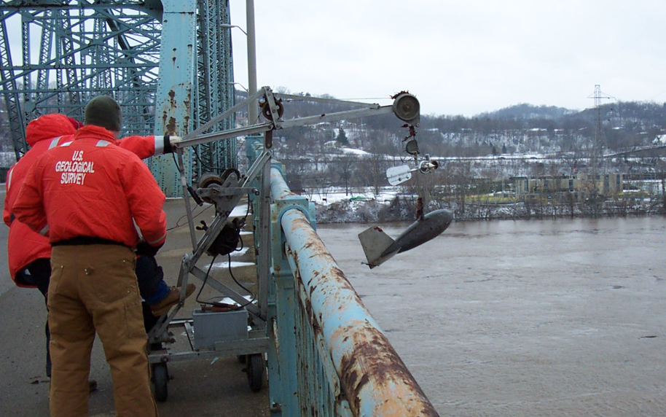
New and Emerging Technologies for Water Science at the USGS
NOAA Technology Summit
November 4, 2010
Silver Spring, MD
Jerad Bales
USGS Chief of Research for Water

Slide 2
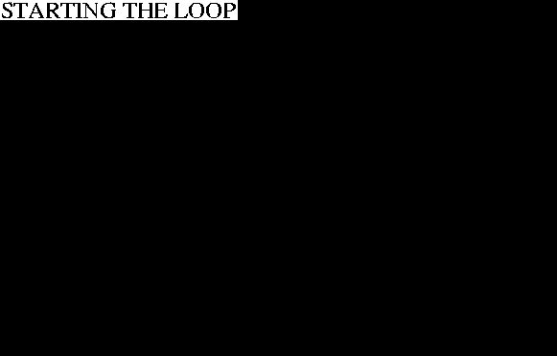

Overview
Instrumentation
  Streamflow
  Groundwater
  Water Quality
Modeling
Data Management

Slide 3
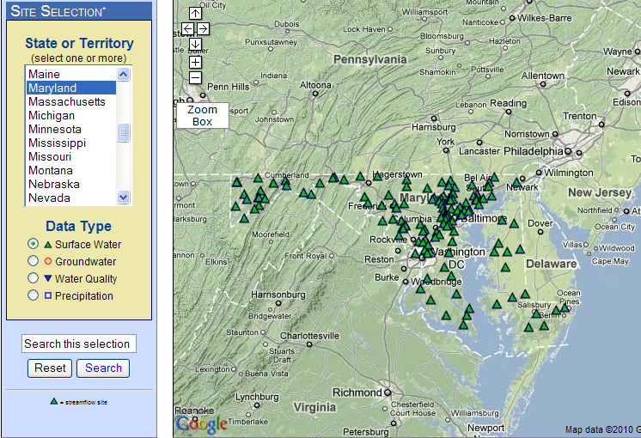
USGS WaterAlert
http://water.usgs.gov/wateralert/

Slide 4
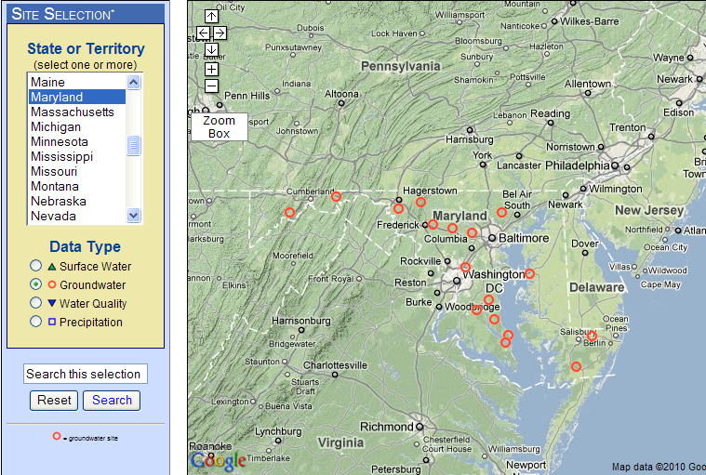
USGS WaterAlert
http://water.usgs.gov/wateralert/

Slide 5
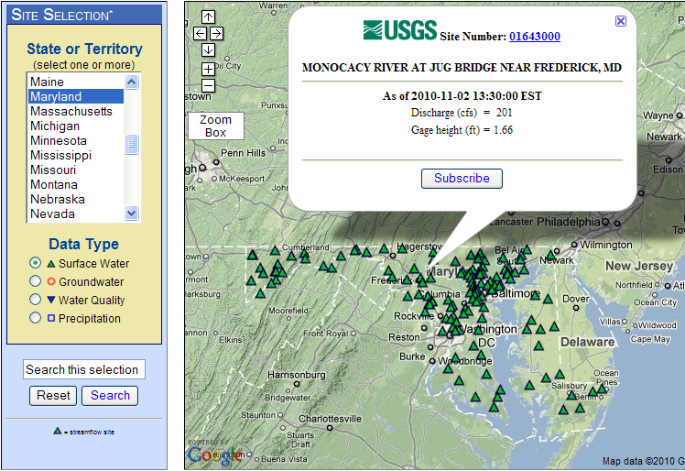
USGS WaterAlert
http://water.usgs.gov/wateralert/

Slide 6
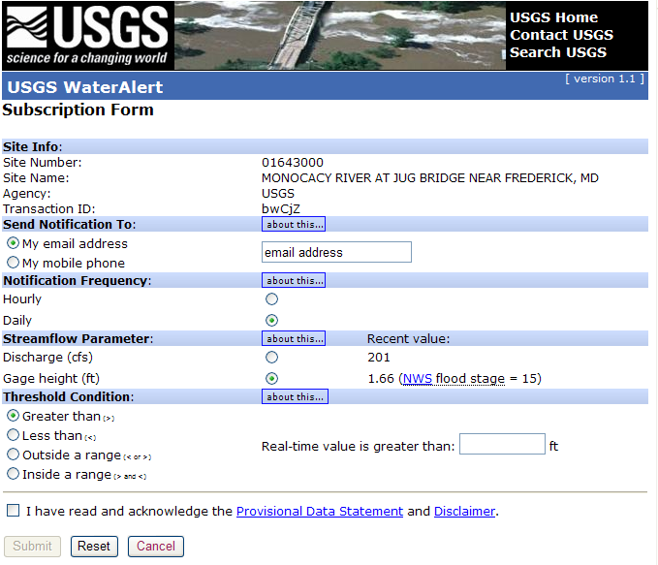
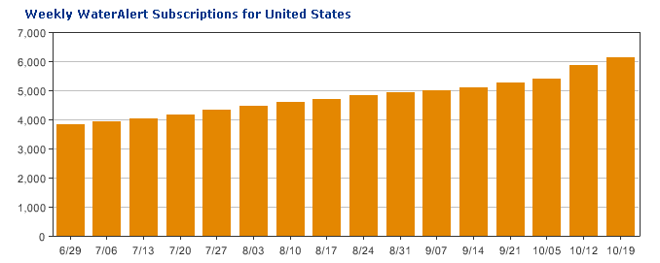
USGS WaterAlert
USGS StreaMail
To: streamail@usgs.gov
Subject: 01607500
http://water.usgs.gov/wateralert/

Slide 7
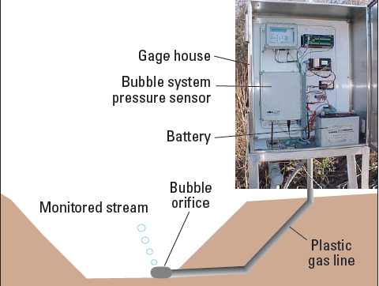
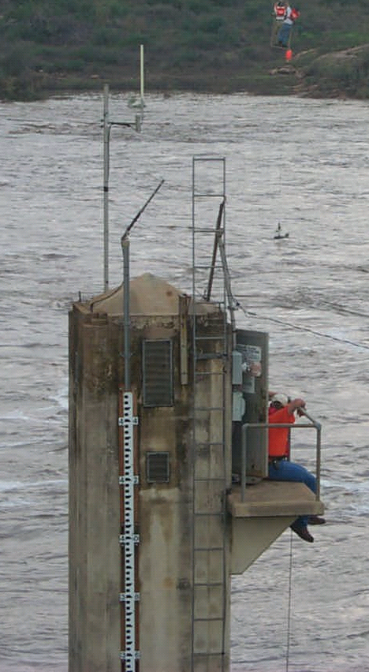
River Stage: Pressure Transducer
Relative to stilling well:
Easier to install
Easier to maintain
Easier to get above flood stage
No confined space
Subject to channel changes and debris

Slide 8
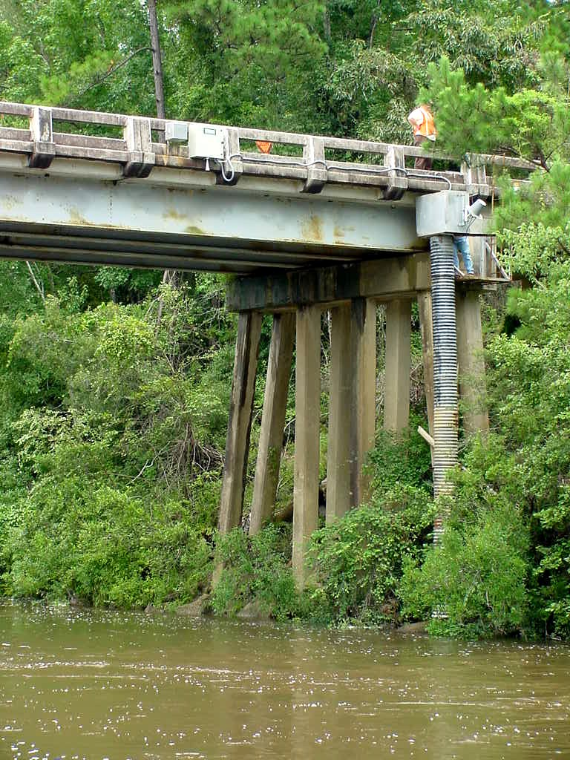
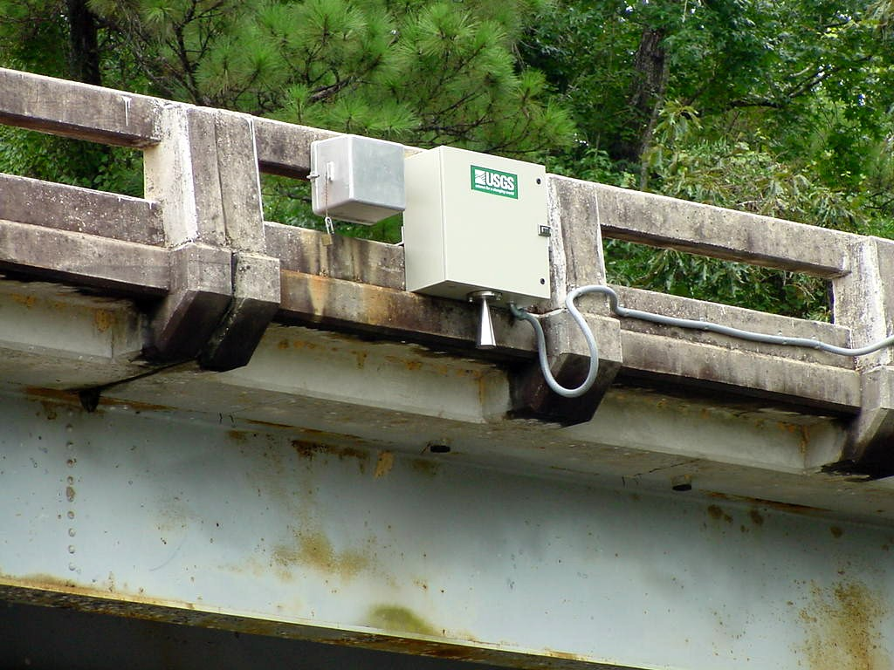
River Stage: Radar
Easiest to install
Easiest to maintain
Easier to get above flood stage
Least potential impact from channel changes and debris
No confined space
Not applicable to ice affected rivers
Must have a structure over the river

Slide 9
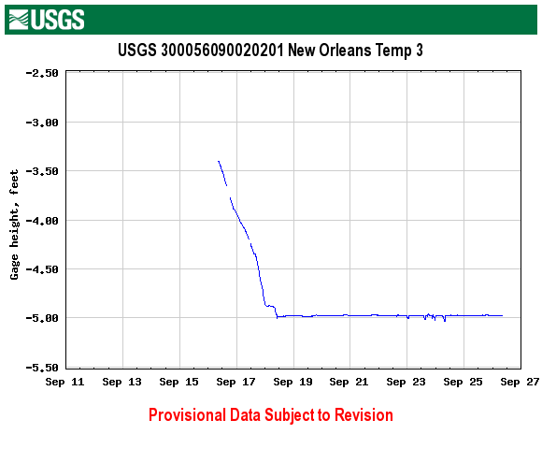
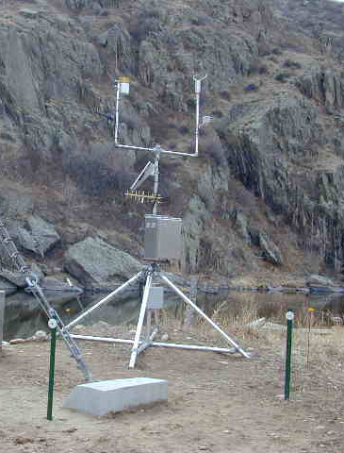
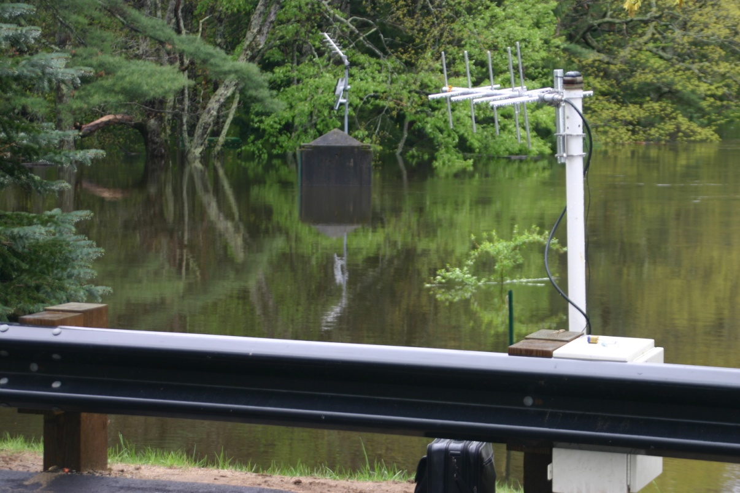
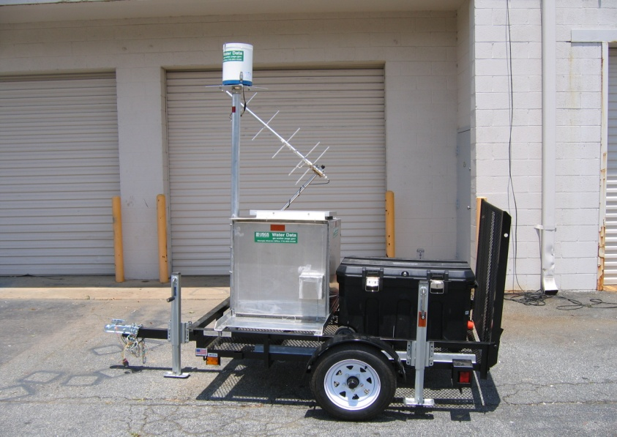
River Stage: Rapid Deployment Gages

Slide 10
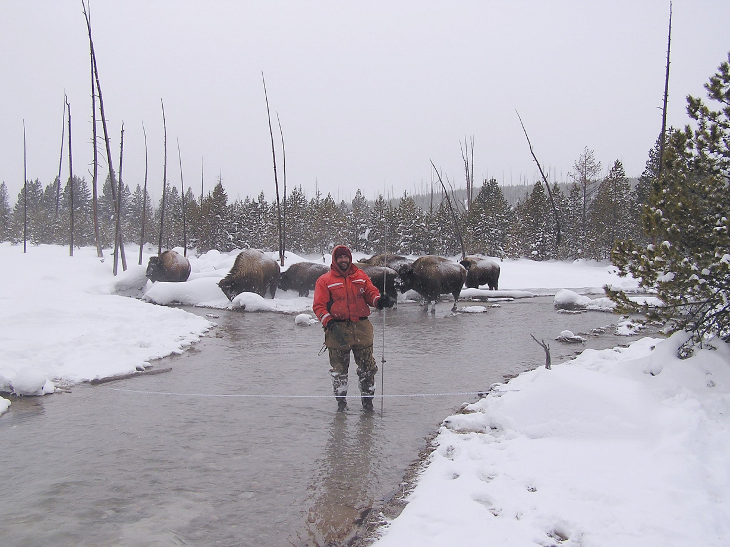
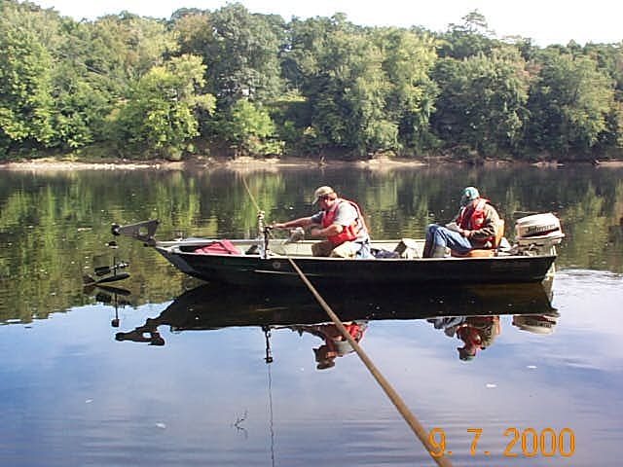
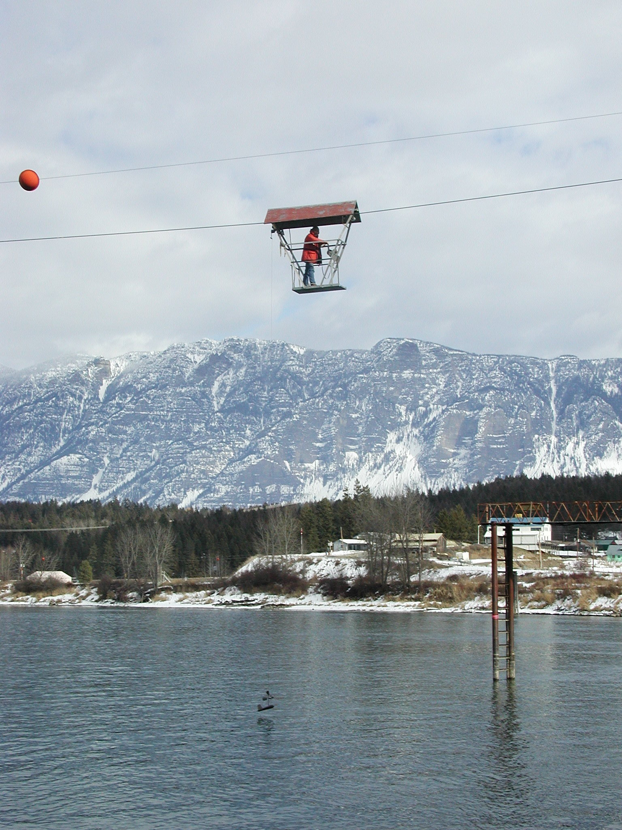
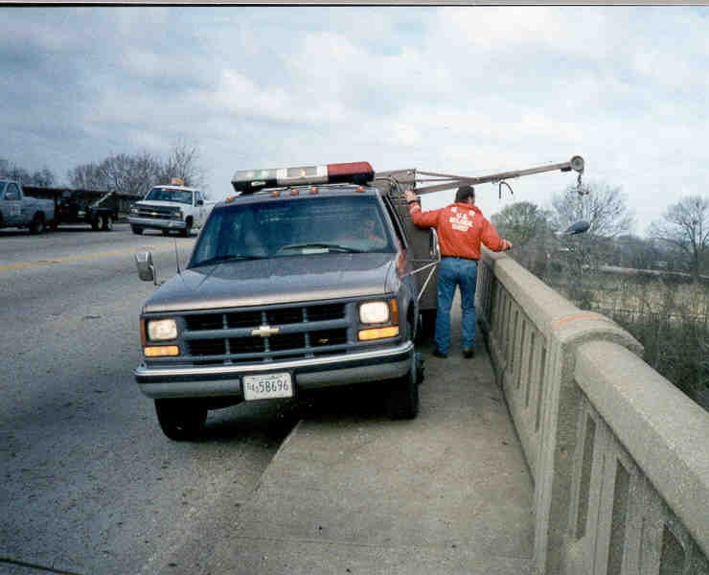
Discharge: Traditional Methods
Boat measurement
Wading measurement
Bridge measurement
Cableway measurement
Notes:
The USGS established its first streamgage station on the Rio Grande at Embudo River, New Mexico in 1889. At the time, early hydrographers worked out the essential practices, tools, and techniques. A flow measurement is made by measuring the depth, velocity, and width of 20-25 sections across the river along a tag line (marked with red ribbons in photograph.)
Until recently (1980’s), we were still using essentially these same tools and techniques. Unfortunately, owing to tight budgets, we are still too often using the same techniques today.
Clearly there a pressing need to incorporate new technologies to speed flow measurement and reduce costs….And that is where we are headed.

Slide 11
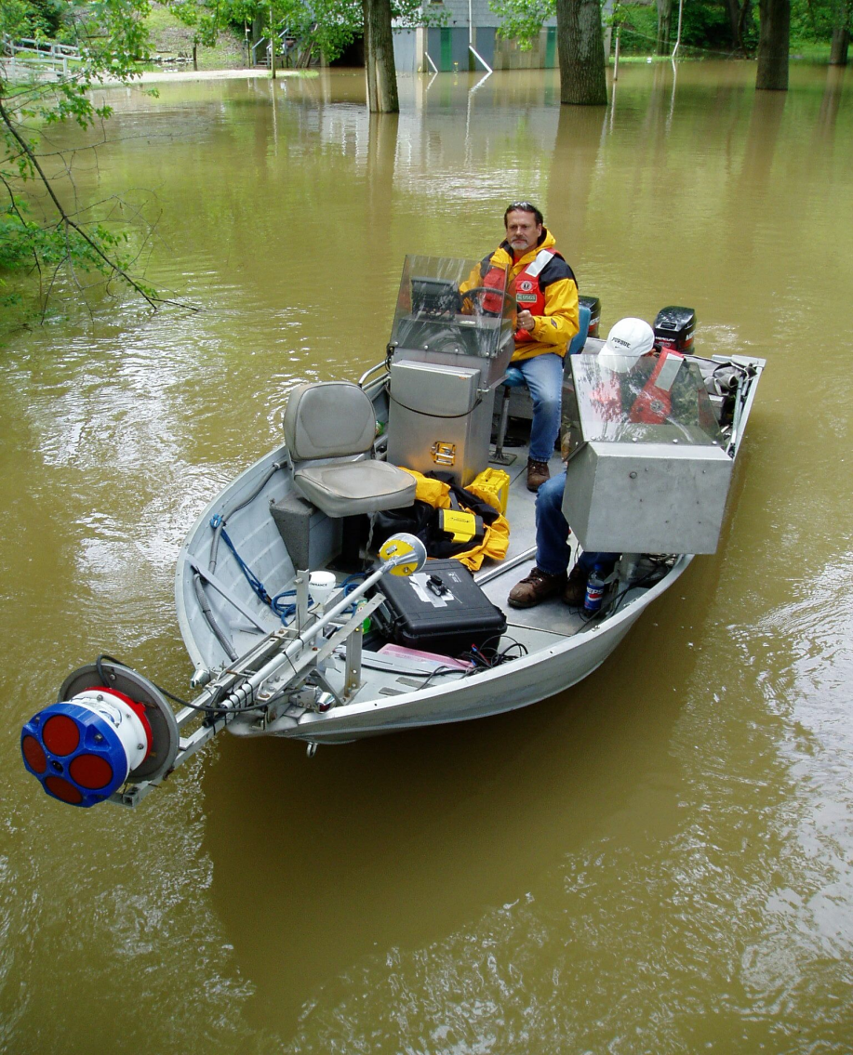
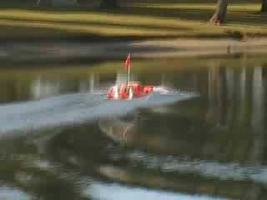
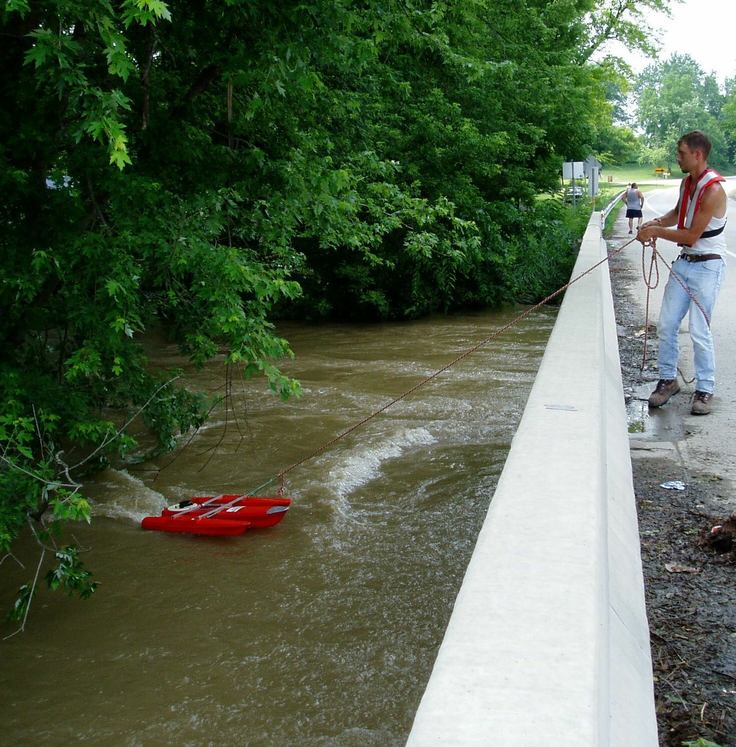
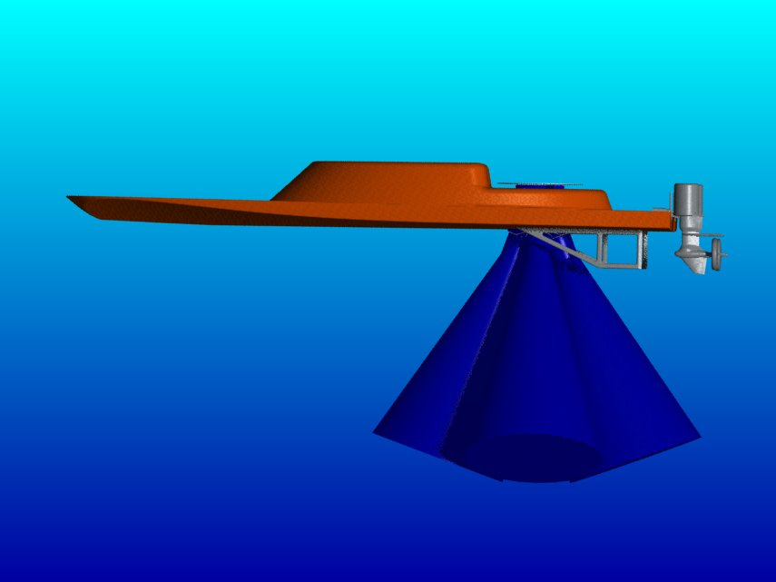
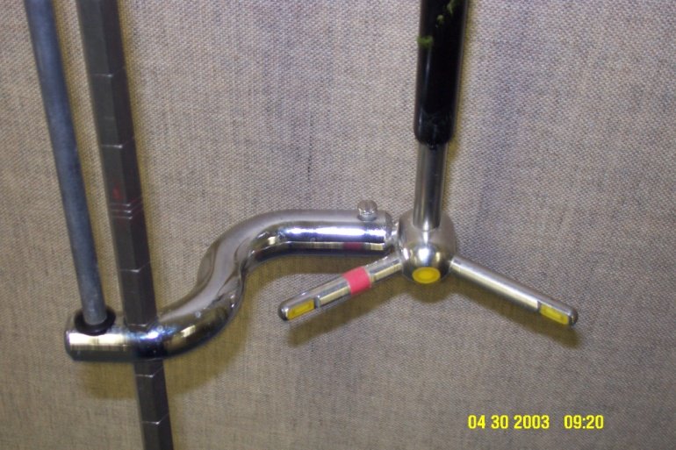
Discharge: Modern Methods
Boat measurement
Cableway measurement
Wading measurement
Bridge
measurement
Notes:
Downsize equipment
More information about flow
Safer and faster

Slide 12
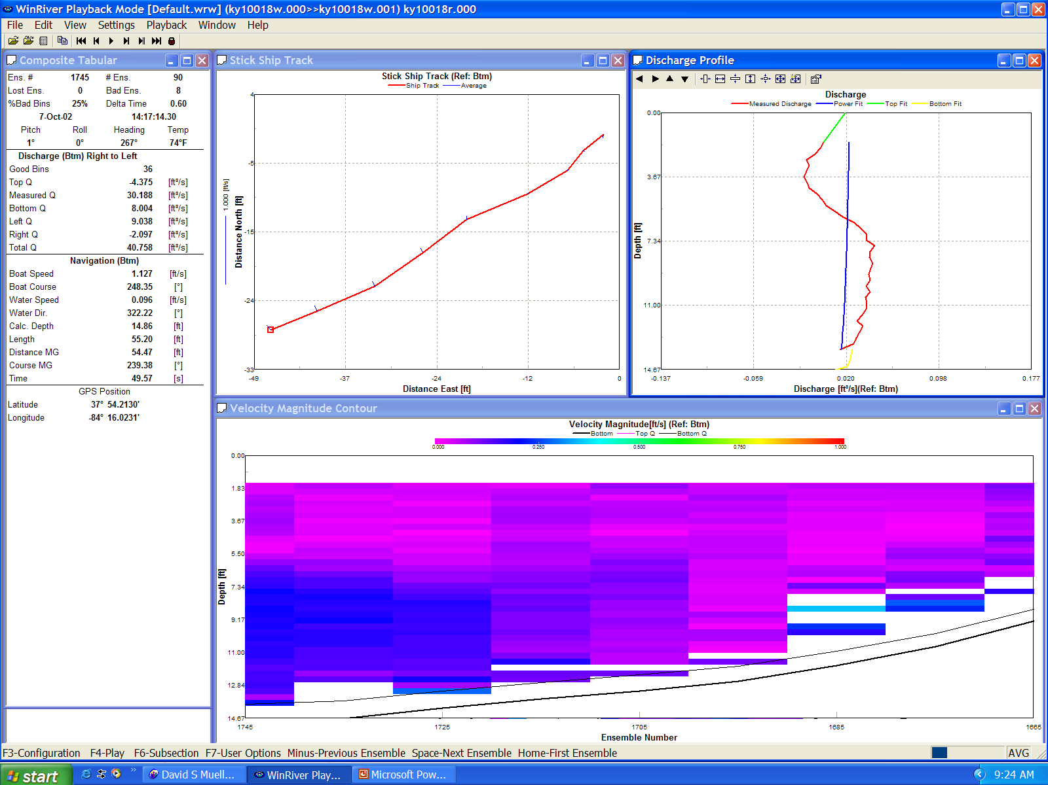
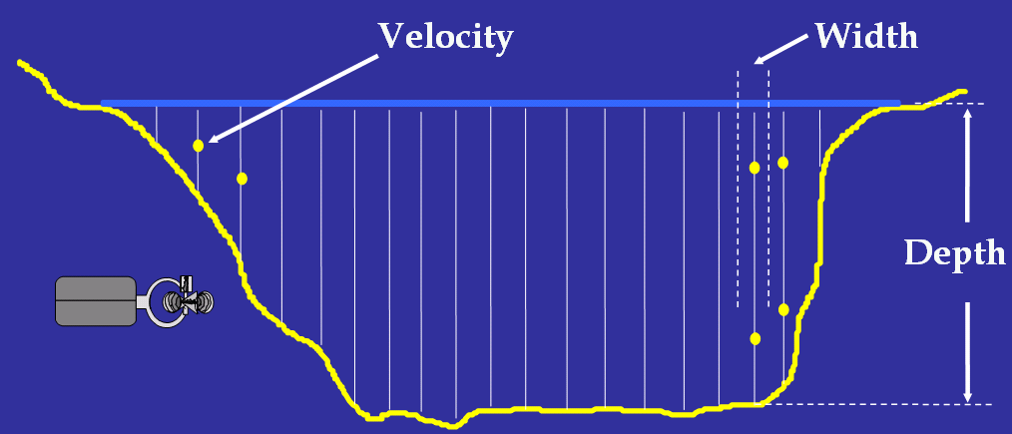
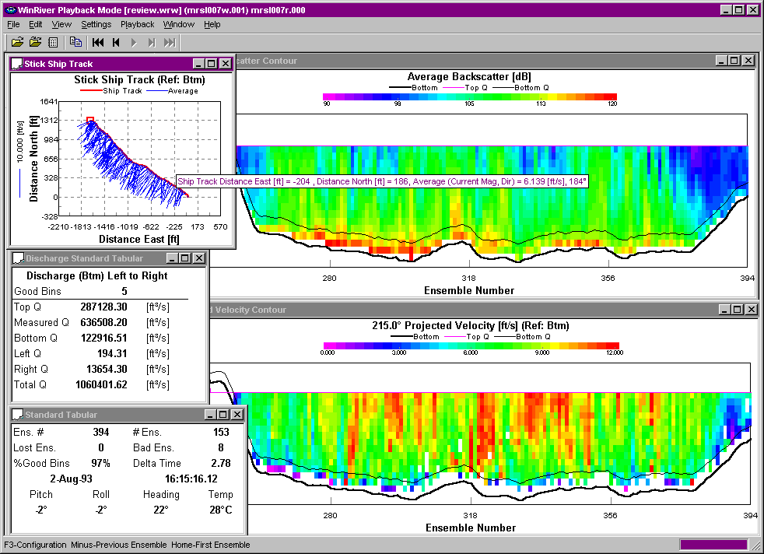
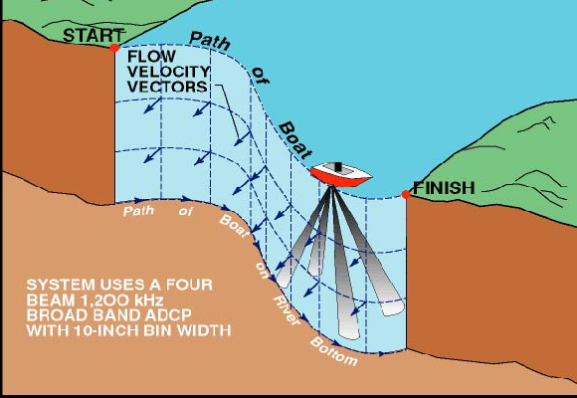
Discharge: More Information
Notes:
Here is a high flow discharge measurement that was made at St. Louis during the 1993 Mississippi River Flood. This transect took less than 10 minutes to make and the measured discharge was > 1 million cubic feet per second. Even 4 passes (as required by OSW policy) would have only taken 30-40 minutes, not counting boat launch and retrieval. In comparison, Price AA measurements made near the gage from the Poplar Street bridge required 4-6 hours.
ADCP’s are great tools for making high flow discharge measurements and allow for significant improvement in efficiency. The Indiana District reported that they were able to make approximately 50 measurements in a 1-week period during a flood event in July 2003.

Slide 13
Discharge: Previously Unmeasureable

Slide 14
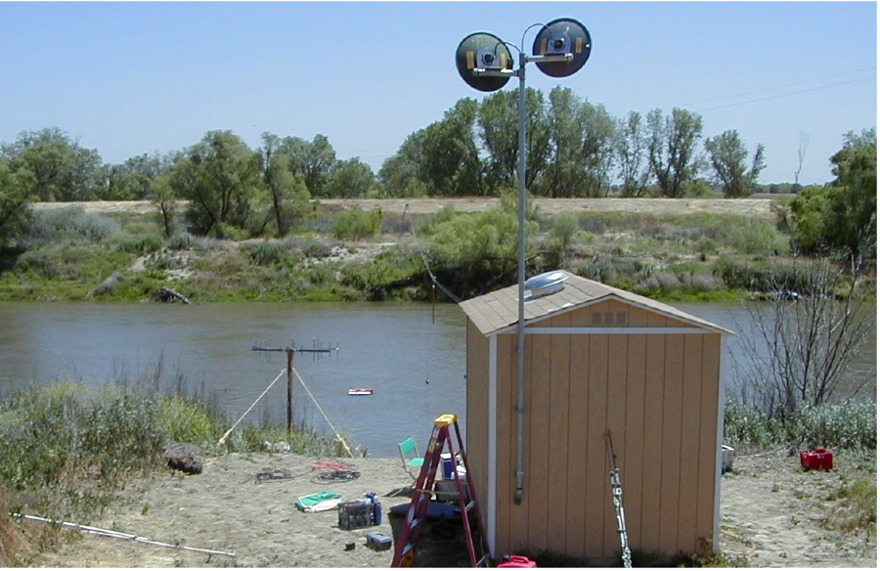
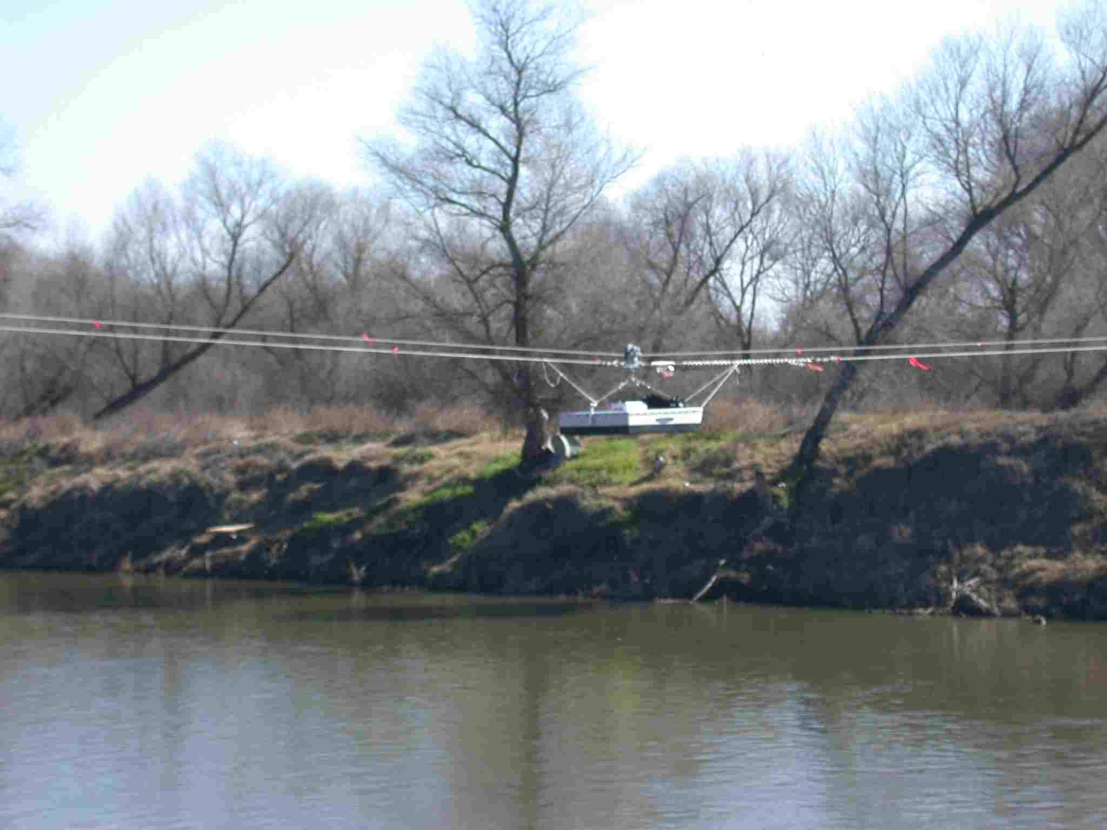
Discharge: The Future?
Microwave Radar: Surface Velocity
Ground-Penetrating Radar: Cross Sectional Geometry
UHF Radar: Surface Velocity

Slide 15
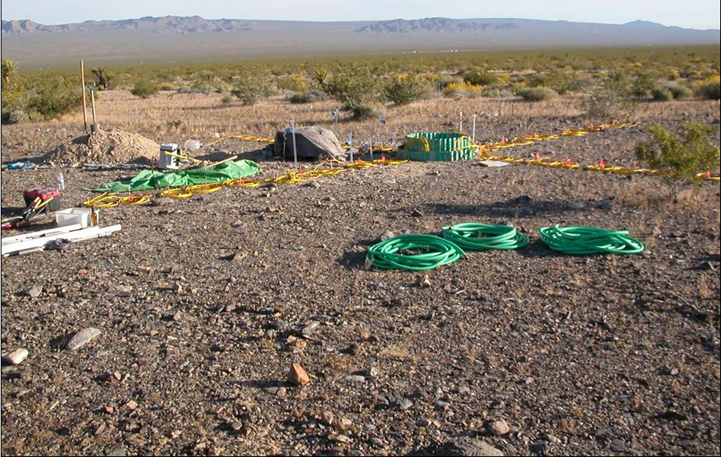
Soil Moisture and Infiltration
1-m infiltration ring
Electrical Resistance Tomography (ERT) setup
Objective: Develop 3D regional representation of soil water properties
and dynamics that can be used to predict habitat suitability.

Slide 16
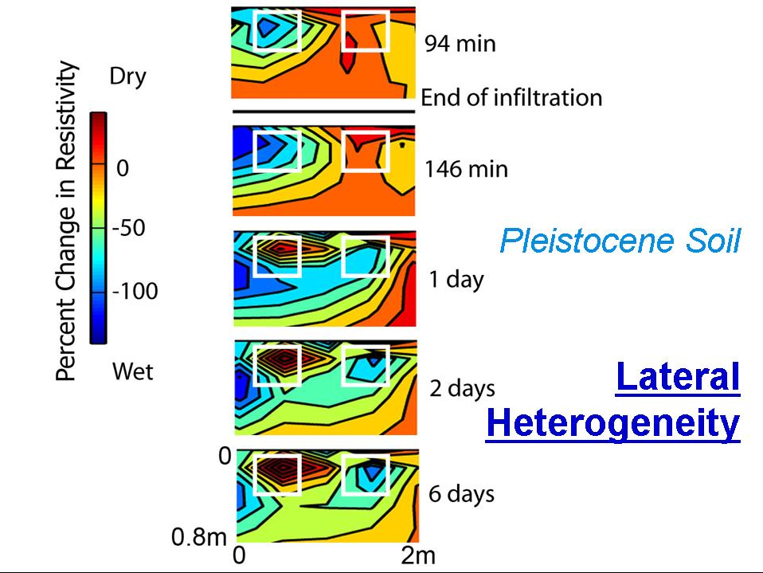
Soil Moisture and Infiltration

Slide 17
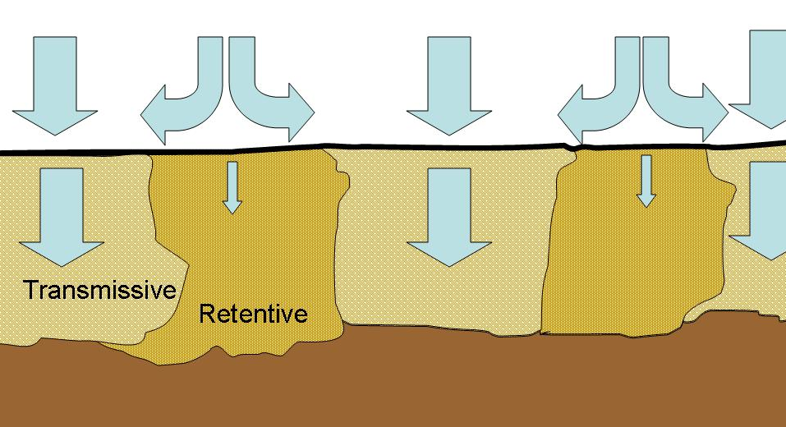
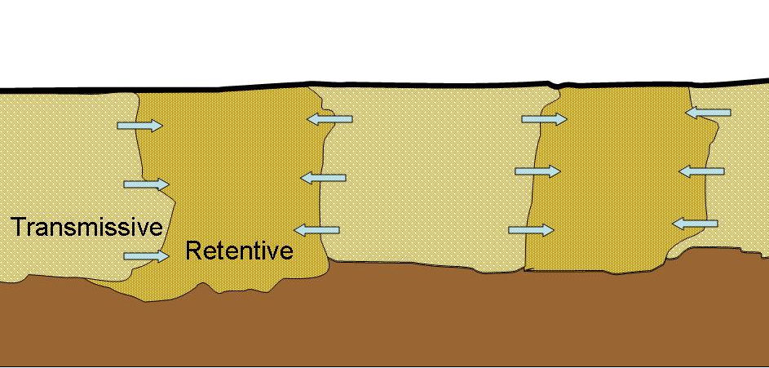
Soil Moisture and Infiltration
During
Rainfall
After
Rainfall

Slide 18
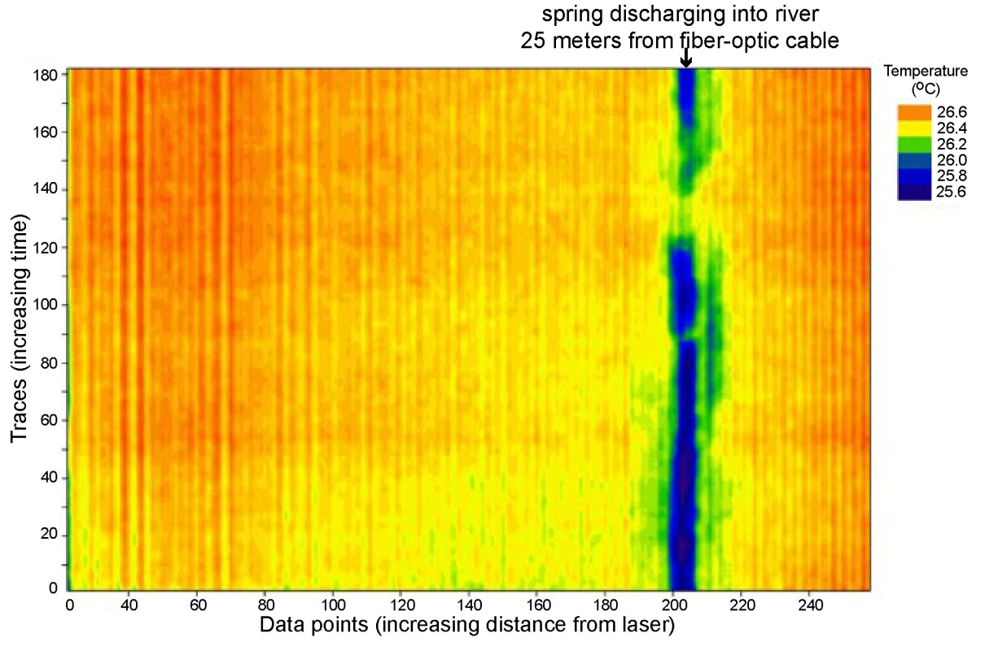
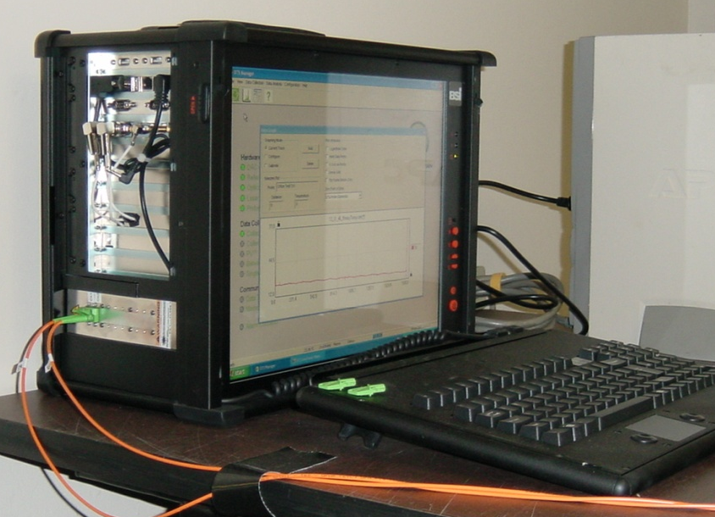

Fiber-Optics for Measuring GW Discharge
Measurements over kilometers
Meter-scale spatial resolution
0.1 °C thermal resolution
Cycle times of minutes
Measurements over km’s
m-scale spatial resolution
0.1 °C thermal resolution
Cycle times of minutes
Shenandoah River, VA

Slide 19
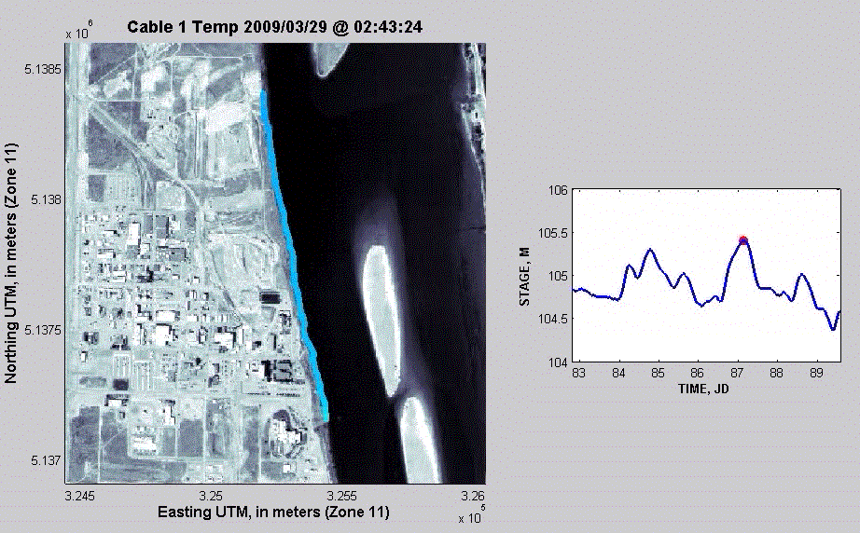
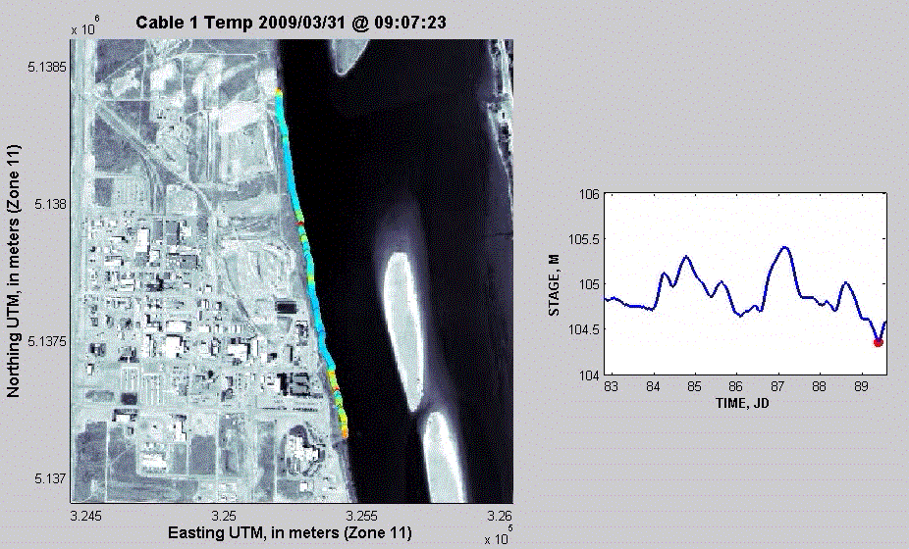
Temporal Variability in GW Discharge: Hanford, WA
High stage
Low stage
Notes:
Ruggedized, 1.6 km long cable deployed 2 m from the bank
(4 other cables deployed up to 20 m from bank, from boat, not shown here)
Cables checked by divers.
Data on a 5-minute time interval every meter along the cable
Remote system access with data automatically transferred to a remote server.
Winter high-stage conditions shows relatively uniform temperature along the cable.

Slide 20
Geophysics for GW Monitoring
  Advantages of Geophysical Performance
  Spatial coverage: provides data between boreholes
  Temporal coverage: Can run continuously and provide near real-time information
  Minimally invasive
  Cost effective compared to chemical sampling
  Can trigger sampling events or site visits
  LIMITATION: Requires calibration/correlation and understanding of resolution
S

Slide 21
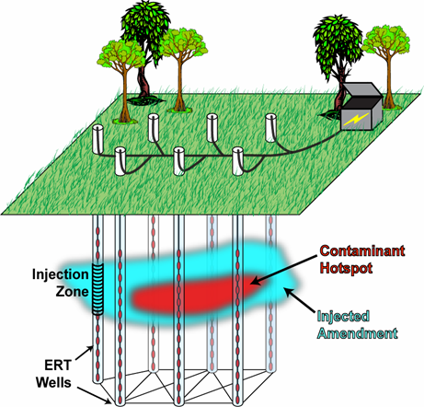
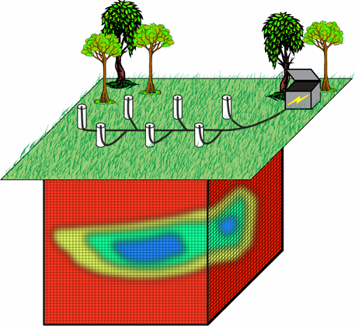
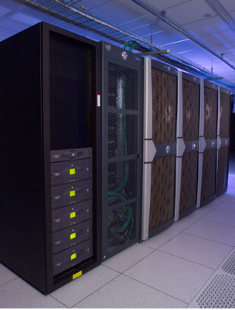
Hydrogeophysical Performance Monitoring System for Biostimulation Brandywine, MD
Automated & on-
demand results
Server: Data QA/QC, Management
Data
Electrical geophysical
Hydrologic
Geochemical
Time-lapse Inversion
Time-lapse
Amendment Maps
Notes:
This schematic shows the overall workflow for our hydrogeophysical performance monitoring system set up in Brandywine Maryland under ESTCP grant 0717. Our objective is to image in 3D the injections of amendments for biostimulation, and to track the migration of the amendments over time. Data are transmitted over the internet to a server at Idaho National Lab for automated processing and inversion, thus providing near real-time information about system dyanmics. USGS partners on this project include Idaho National Lab (Tim Johnson and Roelof Versteeg) and the US Naval Facilities Environmental Service Center (Bill Major).

Slide 22
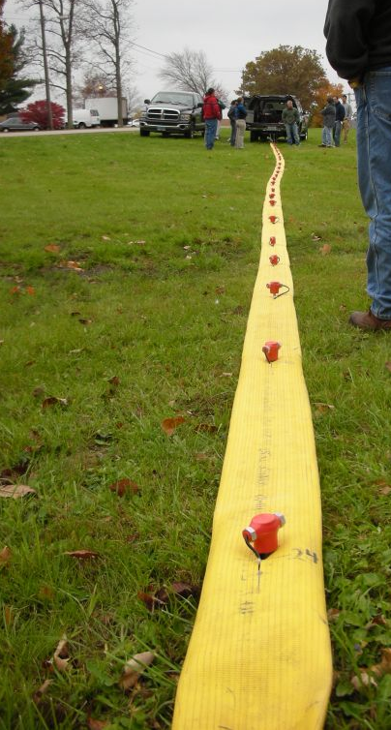
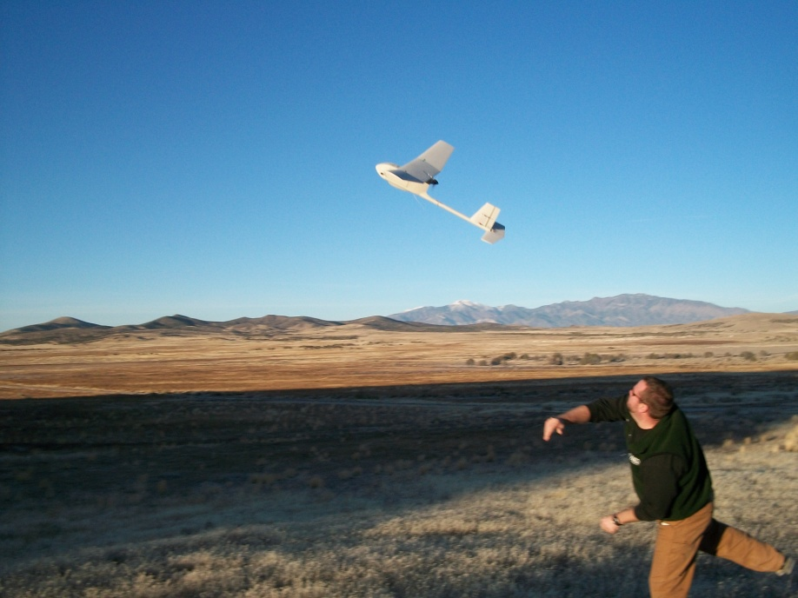
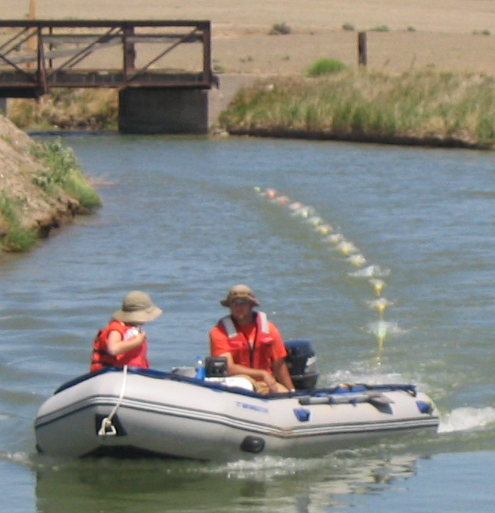
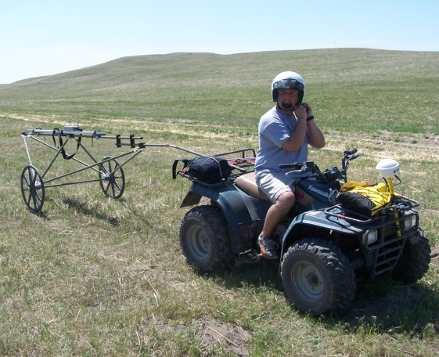
Mobile Geophysics
  Rapid coverage of larger areas: EM-cart, boat-towed electrical imaging
  Low-cost airborne geophysics—Raven
  Towed-Seismic—land streamer
Notes:
One of our principal goals is to scale up our capabilities to cover larger areas more cost effectively. Three emerging geophysical technologies are showcased here: (1) waterborne boat-towed techniques, such as continuous electrical imaging, as shown on left; (2) UAV platforms, such as the Raven, shown at middle; and (3) the seismic landstreamer, which facilitates rapid collection of seismic data.
Raven
Army Surplus sUAS Aircraft
Visual or GPS flights
Current sensors (video and IR) not well suited for hydro science applications
Raven-GEM
Initial development of prototype EM sensor into Raven airframe
~ 50-100m flight lines

Slide 23
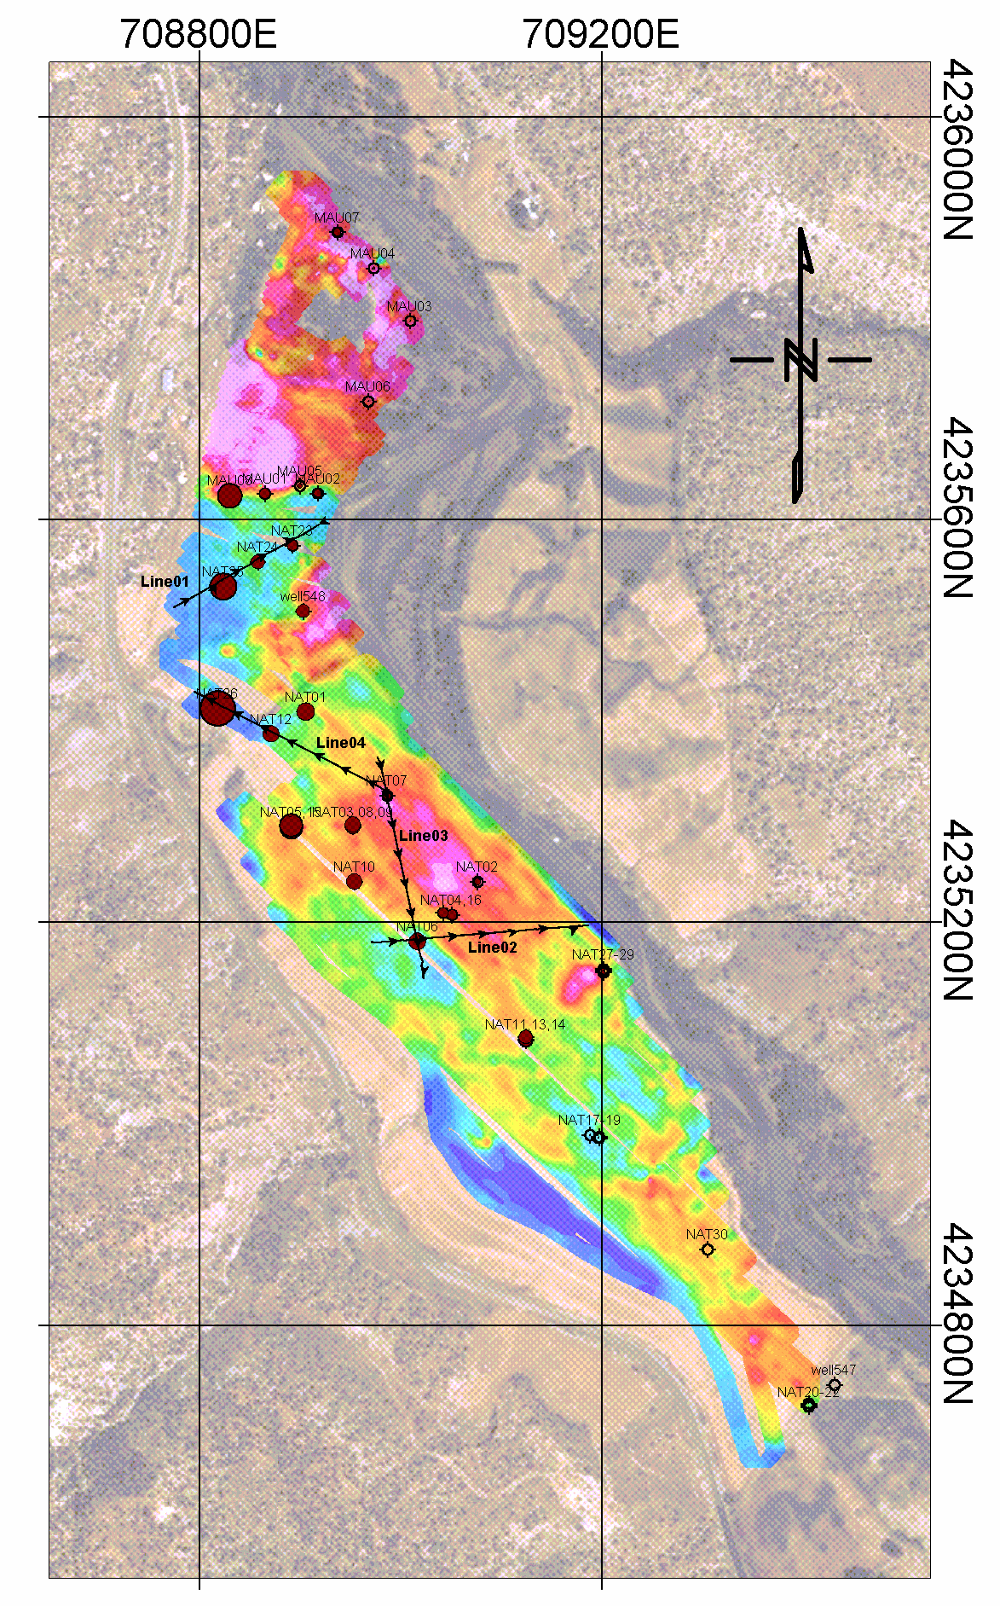
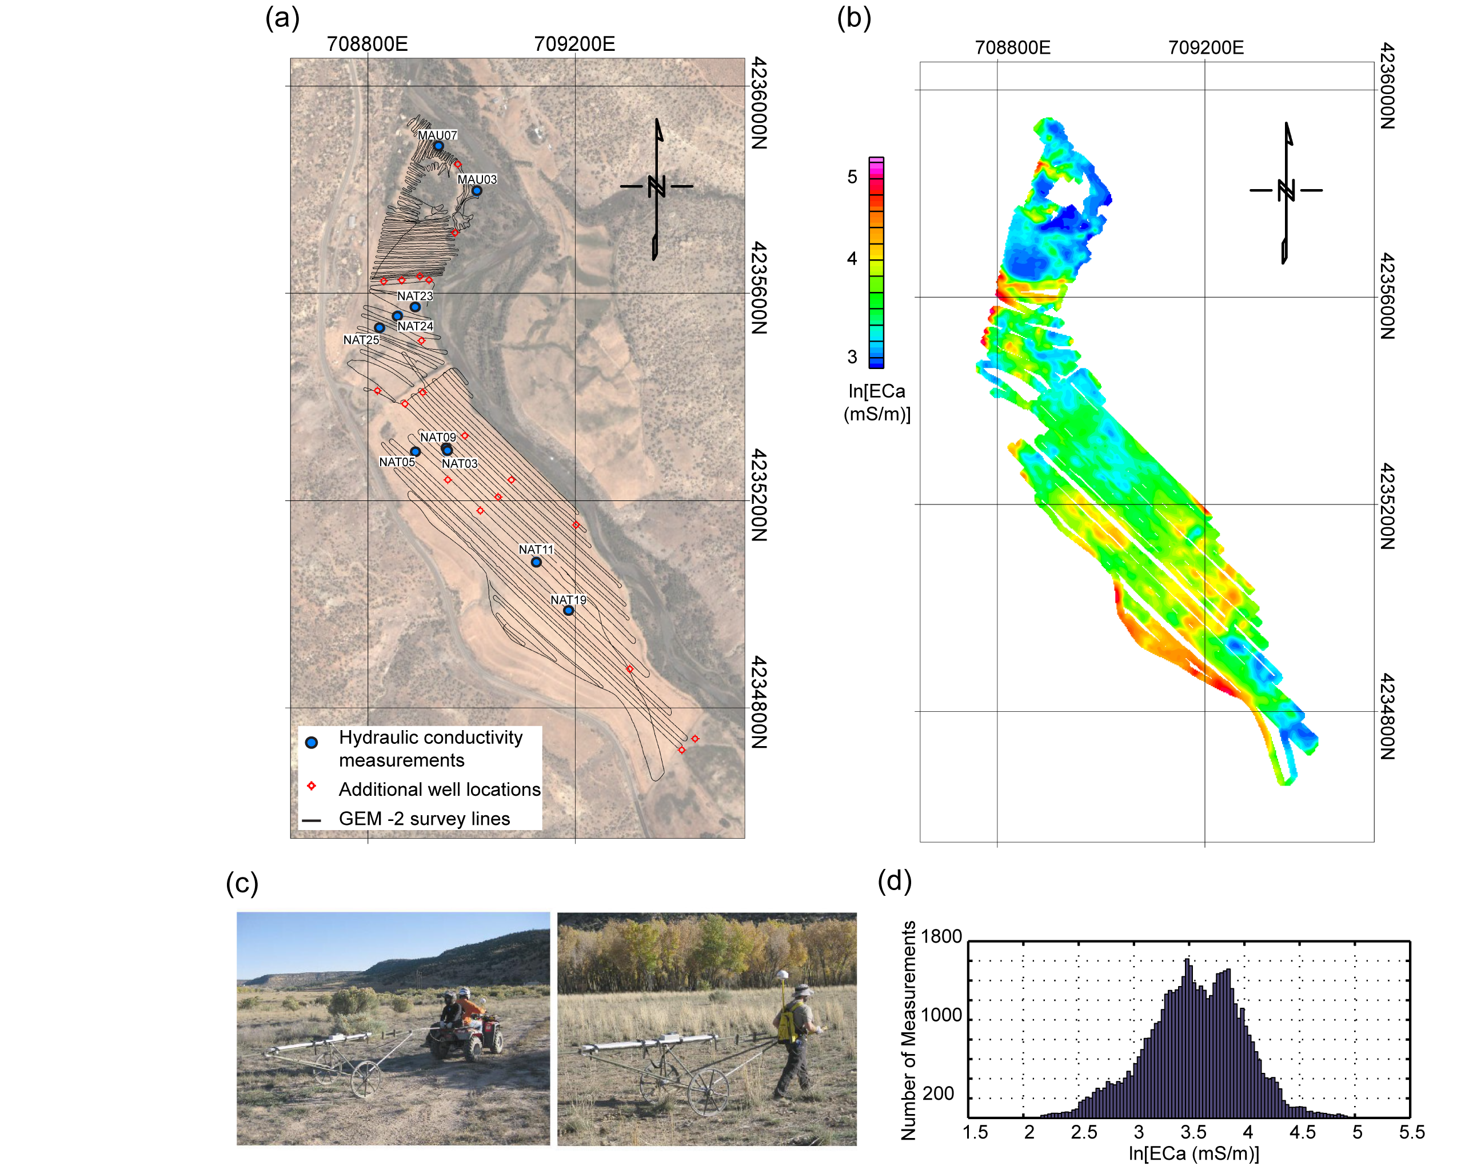
Example: Multi-Frequency EM Mapping
  Case study, Naturia, CO
  Uranium mine tailings site
  Mapped area ~1.2 km x 400 m
  30 line-km of data collected in 2.5 days
  Data inverted for 3D structure
  Estimated EC correlated to K
Notes:
Advances in multi-frequency EM tools now enable rapid collection of data in ATV (or human) towed modes. Data are collected concurrently with GPS, enabling coverage of large areas. In a recent study at a uranium mine tailings site in Naturita, CO, we collected multi-frequency EM data over a 1.2-km by 400-m area to image 3D subsurface conductivity structure. These results were correlated with K at sparse wells throughout the area to estimate spatially variable K. This work was performed in support of research by Jim Davis and Gary Curtis (USGS). A new DOE-SBR (Subsurface Biogeochemical Research)

Slide 24
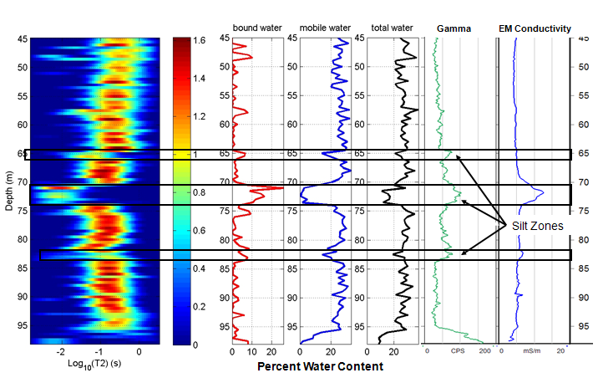
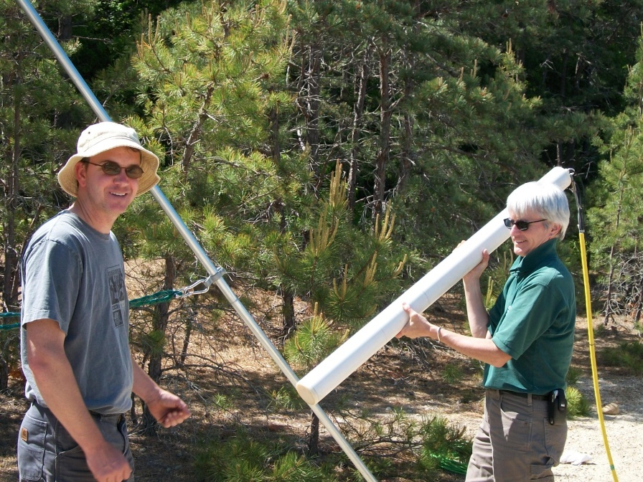
Borehole NMR
Measures water content & pore fluid - grain interactions
Used to estimate
  Total Porosity
  Pore size distribution (bound vs mobile water)
  Hydraulic conductivity variations (k related to mobile/bound water ratio)
  Quantitative estimates of k possible (with calibration)
Notes:
NMR relaxation rate in porous media governed by surface interactions
Water in small pores: fast relaxation
Water in large pores: slow relaxation
USE a COMBINATION of METHODS

Slide 25
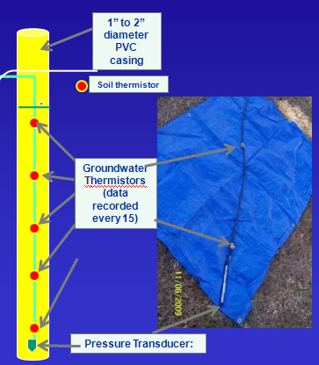

SW – GW Interactions
GW - SW dynamics: canals, ice, recharge
Help work gaging station record:
  Stage under ice
  Flood damage (or unstable controls)
Advanced uses… lots of potential:
  Heat-based estimates of water fluxes
  Water-quality monitoring
  Improved understanding of nutrient loading.
Notes:
Tried to be consistent, but as with anything, not completely possible.

Slide 26

Continuous Water-Quality Monitoring
Detect temporal variations (seasonal, daily, event)
Trigger sample collection
Feedback for regulatory & operational purposes
Increase process-based knowledge
Provide data for modeling
Forecast water quality
Estimate concentrations of unmeasured constituents
AND…..

Slide 27




Improved Sensors and Signal Processing
UV Nitrate
Turbidity
Laser-Based
Acoustic Backscatter

Slide 28


Surrogates for Concentration Estimation
Little Arkansas River near Sedgwick, Kansas
Collect water samples over the range of hydrologic and chemical conditions
Develop site-specific regression models using samples and sensor values
Compute concentrations and loads
Publish regression models
Display computations, uncertainty, and probability on the Web
Continued sampling to verify models

Slide 29

Turbidity estimates E. Coli reliably
Rasmussen, Ziegler, and Rasmussen, 2005
Notes:
6

Slide 30

Information Rich Content
Fecal Coliform
Concentration
Percent Chance
Criteria are
Exceeded

Slide 31

Atmospheric Rivers
“Atmospheric rivers” are characterized by strong horizontal water-vapor fluxes focused in narrow bands in the lower troposphere and often produce heavy coastal flooding, property damage, and occasional loss of life.
Newly developed USGS stable isotope precipitation collection instrumentation is providing new information for understanding physical processes.
Increased understanding of storm processes should improve forecasting.
Notes:
Lower right is satellite image of integrated water vapor 22 March 2005. Atmospheric River headed for Northern California. BBY is Bodega Bay site.

Slide 32


Combining USGS’s expertise in isotopes with NOAA’s meteorological capabilities to study atmospheric processes in “atmospheric rivers”
S-PROF radar reflectivity profiles of precipitation at Cazadero, California
96 sample precipitation collector for stable isotopes and chemistry, developed by USGS (patent pending)
Hydrogen isotopic variations providing new insights on atmospheric moisture sources and processes
Notes:
Lower left panel shows novel USGS collector at Cazadero, CA. International Atomic Energy Agency (IAEA) has come to USGS and asked us to provide a collector for arid environments, e.g., Africa.
Project continuing full steam ahead--four collector are being colocated at Northern CA NOAA observatories this winter.
Upper right panel shows S-PROF radar reflectivity profiles obtained by NOAA instrumentation March 2005 when an extratropical cyclone made landfall in California. Note that time goes right to left, the standard method for meteorologists.
Lower right shows stable hydrogen isotopic measurements at 30-minute intervals through this event. Note the remarkable decrease in hydrogen isotopic composition followed by an equivalent increase with onset of the atmospheric river (increase in rainfall as indicated in the third panel).

Slide 33


Flood Inundation Mapping and Modeling

Slide 34
Static vs. Dynamic Maps
Static Maps
Library of maps always available.
Maps available for full range of flow conditions.
Does not reflect unsteady flow conditions.
Effects of debris not included.
Dynamic Maps
Can be used with forecast hydrograph.
More accurately reflect flow conditions.
Rapid model implementation required.
Model must be stable over range of expected conditions.
Effects of debris not included.

Slide 35

Experimental Dynamic Mapping
White R. Indianapolis.
Application mines NWS forecasts and USGS data.
Automatically initiates during floods.
Produces flood maps for up to 5 days out.
Monetary loss estimates also provided.
High-speed computing required.
Not publicly available.

Slide 36

Notes:
Flex Viewer

Slide 37

GSFLOW—Coupled GW – SW Modeling
Simultaneous simulation of flow across the land surface, within saturated and unsaturated subsurface materials, and between terrestrial and surface-water domains.
Single or multiple watersheds ranging from a few to several thousand km²
Time periods ranging from months to several decades.
Daily time steps.
Notes:
GSFLOW—Couples the Precipitation-Runoff Modeling System (PRMS) with MODFLOW-2005

Slide 38

GS-Flow
PRMS hydrologic response units (colored basins) intersected with
ModFlow finite-difference cells.
Enhanced soil-zone dynamics (capillary, gravity-flow, and preferential-flow reservoirs).
Vertical unsaturated-zone flow below soils, streams, and lakes using approx. to Richards’ equation.
Model-calculated recharge to water table.
Sagehen Creek watershed, Truckee, CA

Slide 39


Example: Santa Rosa Plain, CA
16,741 HRUs (10 acre cells)
16,741 active MF cells per layer
14 layers (50 to 500 ft thickness)
2,902 stream reaches

Slide 40


34-Year Water Balance

Slide 41


Slide 42


Slide 43

Simulation of Flow and Morphologic Change
Relatively low spatial and temporal resolution flow model: 1min < ∆t < days, 1m < ∆x,z < 0.1w,D
Computational models for bedload and suspended load prediction.
Time stepping to predict evolution of bars and, in some cases, planform geometry.
If bedforms change over time, calibration of roughness is required or both flow and morphodynamics will be incorrect

Slide 44


Simulation of Flow and Morphologic Change

Slide 45



Field Computing
Notes:
USGS is in the process of converting paper forms into electronic applications for water-data collection. The applications sync with a database and provide employees a one-time data entry solution for data collection. The system makes use of some of the newest technologies in order to deliver data to the public in a timely manner.

Slide 46








Electronic Field Data
Surface-water measurements
Station levels
Water quality monitors
Groundwater measurements
Growth of use, 2009 - 2010
Notes:
Software works with a variety of Windows Mobile devices to include multiple data-collection platforms and vendors. USGS has developed and supports applications for Surface-Water Measurements And Inspections (SWAMI), Station Levels, Continuous Hydrologic Instrumentation Monitoring Program (CHIMP), and Multi Optional Network Key Entry System (MONKES; a.k.a. groundwater measurements). Growth of electronic entry of surface-water measurements has been tracked since the release of SWAMI in July 2009 and has been steadily replacing manual entry of measurements. [Slight decline in September 2010 is attributed to fewer measurements entered overall due to combined effect of scheduled annual update of NWIS and delay of measurements until new Water Year on October 1.]

Slide 47
Improved Data Availability
USGS NWIS Water Web Services
  Solid, highly-reliable, next-generation ways for acquiring NWIS real-time and other data
WaterAlert
  Threshold notifications sent to email addresses or as text messages
Emergency Data Distribution Network (EDDN) customer services
  View raw GOES DCS messages
  Web, PDA or cell phone access to DCP data

Slide 48
USGS Water Data Web Services
USGS water data requests keep growing
80-90% of data requests are for real-time data
Half or more of all requests are automated
USGS is focused on more robust and optimal ways for delivering and integrating water data using web services
New instantaneous values web service now available
http://waterservices.usgs.gov
Data requests in millions
Notes:
Web services are a more standard 21st century way allowing business-to-business exchange of data over the Internet. Current data formats (tab-delimited) are considered last generation. The USGS is concentrating on developing highly available core water web services. The first big delivery occurred over the summer with the delivery of an instantaneous values web service. This service is very flexible allowing multiple sites and parameters to be retrieved at a time, using common filters like by state and watershed.
A site service and a daily values service are also available to the public. These will be reengineered in FY2011. The instantaneous values service will also get new features and new data delivery formats, including Microsoft Excel.
The big trends that web services facilitates are data integration (think latest USGS water data showing up on the Weather Channel) and multi-disciplinary research (integrated science), including within USGS.
USGS partners like NOAA and USACE should be aware that these services may be new but they are “production” supported services. Users can depend on these data-services with confidence that the service should always be around and highly available 7/24/365.
As a side note: these services will also be used to create a next generation version of NWISWeb, allowing NWISWeb to be more useful to the public and easier and faster to maintain than at present.

Slide 49


Water-Quality Data Exchange Portal
Data Standards
(WQX, SRS, NEMI)
Catalog /Register
WQX Portal
Web Services
3M sites
180M results
USGS NWIS
EPA STORET
Notes:
Web Services allow for more accessibility to the data
No longer limited to EPA or USGS interfaces for interacting with the data.
Provide a commonly formatted dataset for data analysis and modeling
Serve as the backbone for project data applications (mashups)

Slide 50


Slide 51

DSS for SPARROW Modeling
SPAtially Referenced Regressions On Watershed Attributes (SPARROW)
Development underway of 7 regional nitrogen and phosphorus models
DSS Tool provides public face to these and other SPARROW models
Notes:
New England: RF1 (1:500,000)--2,462 Reaches
NE SPARROW Enhanced NHD (1:100,000)--42,000 Reaches

Slide 52

SPARROW DSS
Notes:
Common repository archive for SPARROW models
Provides four general functions:
Description of water-quality conditions
Distribution of sources
Evaluation of delivery to downstream water bodies
Scenario testing of altered inputs
Design Goals
No needed software besides web browser
No users manual – familiar and easy to use
Store and serve models with minimal impact on modeler
Reach multiple audiences and applications
Save scenarios, manipulate locally, share and upload

Slide 53

Contact Information
Dr. Jerad Bales
jdbales@usgs.gov
703-648-5044
Web resources:
USGS Water Programs: http://water.usgs.gov
Water Census Initiative: http://water.usgs.gov/wsi
Flood Inundation: http://water.usgs.gov/flood_inundation
USGS streamflow measurement
during Red River of the North floods

Slide 55


Gravity Monitoring: Aquifer Storage Change
Notes:
Objective: Monitor changes in gravitational acceleration associated with changes in aquifer storage (water mass change) and relate to bedrock structural controls and karst features controlling flow of ground water
Great Valley Hydrologic Gravity (HydroGrav) Monitoring project - monitoring network that traverses the Shenandoah Valley from the Blue Ridge in northern Clarke County to Little North Mountain in northern Frederick County and parallels the West Virginia-Virginia border.

Slide 56


Time-Lapse Electrical Resistivity Tomography
- 8 Chem sample wells
- 7 ERT/Chem wells
- 35 Chem sample ports
- 165 electrodes
(b) Time-lapse
(a) Background
→ Continuous, automated, monitoring
Notes:
On the left is the background electrical resistivity tomogram, showing (1) a surficial high-cond layer where fill material was emplaced after removal of PCB-contaminated soil, (2) a lower-conductivity aquifer; and (3) a higher conductivity confining layer at about 10 m depth. On the right are a series of time-lapse resistivity snapshots showing the emplacement and subsequent spreading of a conductive amendment consisting of ABC (anaerobic biochem – a mix of lactic esthers) and a sodium-bicarb pH adjustment. Two separate injections are imaged in this sequence.

